Slide 1

Design of Microwave Polarizers for Wide Band Radar Cross Section Reduction
MINOR PROJECT -2 END-TERM EVALUATION
Presented by: Under the Supervision of:
Preet Singh Sodhi 9920102021 Dr. Ashish Gupta
Swarnim Pathak 9920102023
Akshat Sinha 9920102032
Department of ECE
Jaypee Institute of Information Technology, Noida, U.P., India

Slide 2
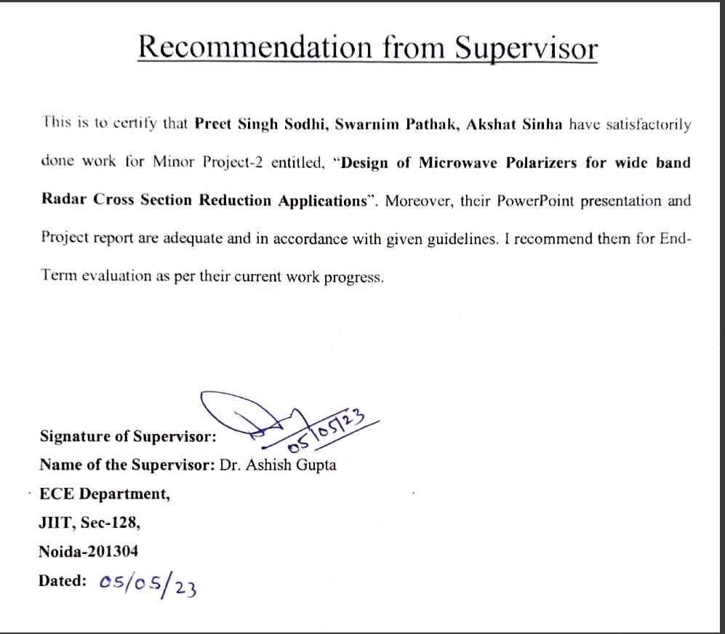
Recommendation from Supervisor

Slide 3
Problem Identification
Design of Microwave Polarizers is a critical issue as those can be used for multiple applications in modern wireless communication. These applications are:
1. Radar cross section reduction: Suitable polarization converters may be designed to exhibit a phase difference of 180 ̊ among two unit cells. The periodic arrangement of such unit-cells may cancel the waves with each other to get the radar cross section reduction. These converters can be suitably integrated with antennas to verify its characteristics in real time.
2. Achieving Polarization Conversion Efficiency:
The Microwave Polarizers available in current scenario are narrow band so we need to propose a structure which is minituarized and exhibits a Polarization conversion efficiency greater than 90% in a wide band Frequency . The physical Microwave Polarizers can be integrated with antennas or a large metamaterial surface to verify the change in phase difference.

Slide 4
Objective
To design Polarization converter and to achieve following parameters
Polarization conversion ratio (PCR) or efficiency must be greater than 90%.
Simulation and Analysis of model in HFSS design.
Check Performance and obtain results for different S parameters.
Phase difference should be 180 ̊ to achieve Radar Cross Section reduction.
To Plot Monostatic and Bistatic RCS report to check for reduction in RCS.

Slide 5
Scope of the Project
Polarization is an important characteristic of electromagnetic (EM) waves. In many related applications such as life science microscopy, fiber-optic communication and radar remote sensing. To this end, conventional approaches are well-developed by taking advantage of birefringent crystals, Faraday rotations or Brewster angle effects.
Broadband RCS reduction has many applications in stealth military platforms such as unmanned aerial vehicles (UAVs), aircrafts and missiles.
The design of multifunctional polarization converters for the X, Ku, K, and Ka microwave frequency bands while providing methods for antenna RCS reduction, polarization beam modulation, and electromagnetic stealth design of military equipment. [0]
.

Slide 6
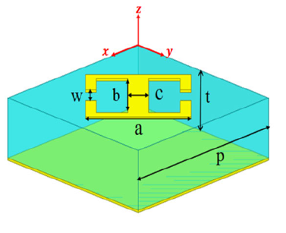
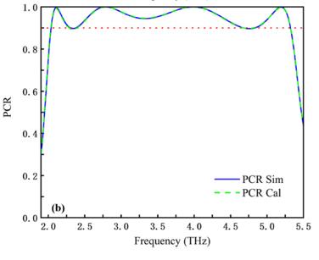
Literature Survey
1.Ultra Broadband Polarization Conversion Meta-surface and its Application in Polarization Convertor and RCS Reduction[1]
In this journal, an ultra-broadband and high-efficiency polarization conversion meta-surface is presented in the terahertz region.
The meta-surface is similar to a sandwiched structure, which is composed of the top Double Split Ring Resonator (DSRR), an intermediate dielectric layer and a bottom metal layer is shown in (Fig.1) .
Both the numerical simulation and theoretical calculation results indicate that the polarization converter can convert in a wide frequency range of 2.04 THz to 5.33 THz with a relative bandwidth of 89% and the PCR is higher than 90%.[1](Fig .2)
Fig.1 The structural parameter of MetaSurface
(Fig. 2) Theoretical and Simulated Results converting linear polarized wave into cross polarized

Slide 7
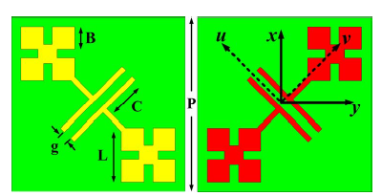
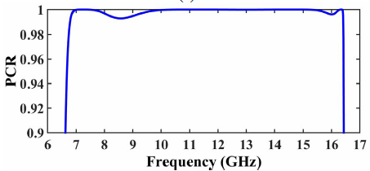
Literature Survey
2) RCS Reduction of a Microstrip Antennas Using Cross Polarization Conversion Metasurface.[2]
In this paper, polarization conversion metasurface for both in-band and out-of-band radar cross section reduction and gain improvement of a microstrip patch antenna is presented.
A chessboard-like metasurface is realized using this unit cell and its mirrored one to achieve the required phase cancelation. The patch antenna is placed at the center of the chessboard and surrounded by the anisotropic unit cell.(Fig .3) [2]
This unit cell has a polarization conversion ratio (PCR) of more than 98% and 180 reflection phase deference between its diagonal axes.(Fig .4)
(Fig.3) Structural design of chessboard like metasurface
(Fig.4) Simulated PCR

Slide 8
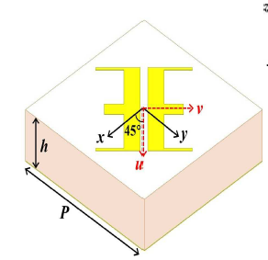
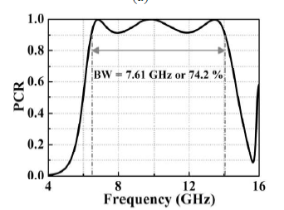
Literature Survey
3) Double E shaped Reflection Type Polarization Converter For Radar Cross Section Reduction[3]
This paper presents a new compact unit cell for reflection-type linear co to cross-polarization conversion. The meta surface is printed on a perfect conductor-backed dielectric substrate. The unit cell consists of double E-shaped resonators.(Fig.5)
The structure exhibits a broadband linear polarization conversion ratio (PCR) > 90% as seen in (Fig. 6)
This converter can be used for stealth technology for radar cross section (RCS) reduction. At frequency 9.8 GHz, the 4 × 4 array of the converter reduces the RCS by more than 21 dB as seen in (Fig. 7) & (Fig. 8) respectively. [3]
(Fig.5) Double E shaped Resonator
(Fig.6) Simulated PCR

Slide 9
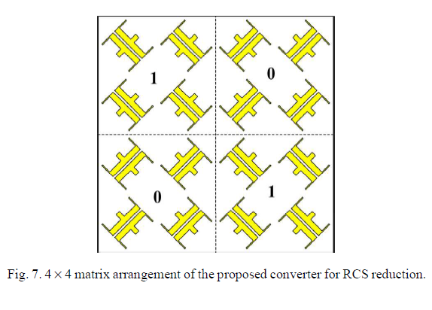
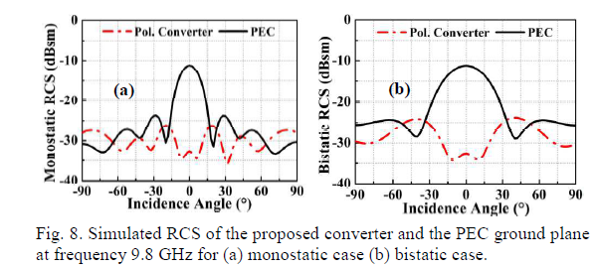
Literature survey
Continued.

Slide 10
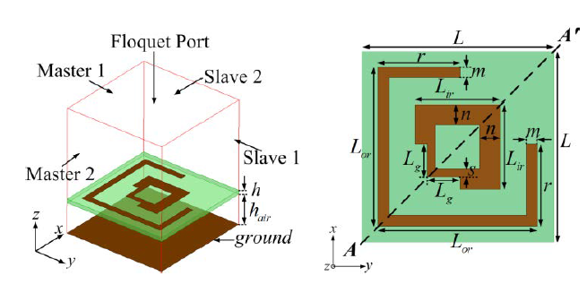
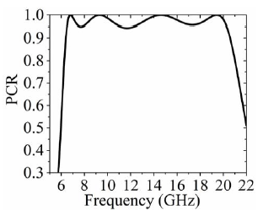
Literature survey
4) Ultrawideband RCS Reduction of Planar and Conformal Surfaces Using Ultrathin Polarization Conversion Metasurface
A metasurface-based polarization converter for ultrawideband radar cross-section (RCS) reduction of planar and conformal surfaces is presented in this paper
The proposed modified concentric double (MCD) square ring resonator-based unit cell which acts as the polarization converter. It consists of two concentric square rings of different widths. Shown in Fig.9
The calculated polarization conversion ratio is plotted in Fig.10. It is observed that the value of PCR is greater than 0.9 over the entire frequency band from 6.3 to 20.5 GHz
Fig.9 Unit cell geometry
Fig.10 Simulated PCR

Slide 11
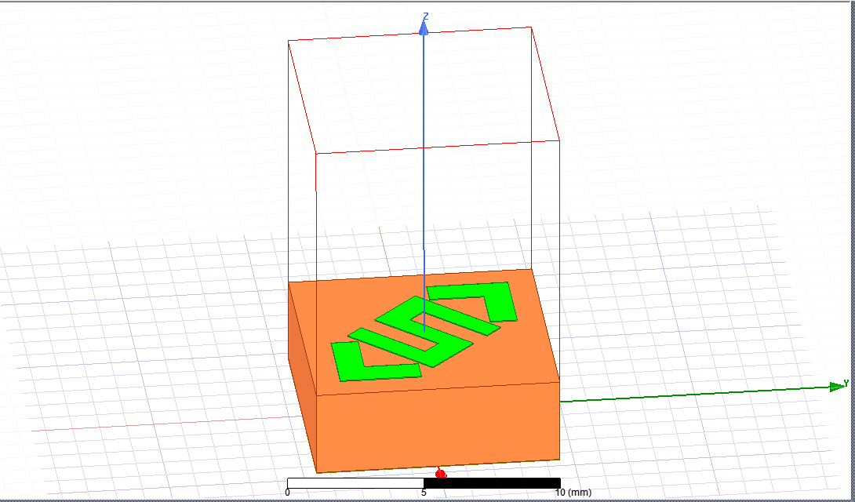
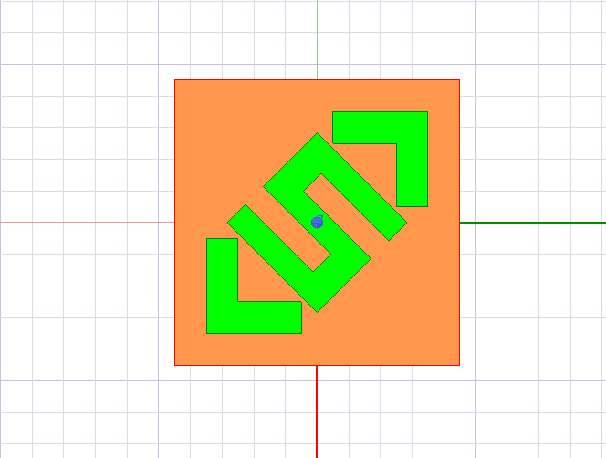
Proposed Structure
Technical work after mid viva
Double L and Single S shaped Microwave Polarizer for Wideband Radar Cross Section Reduction (Fig.11)
(Fig.11) Side View
(Fig.11) Top view

Slide 12
Design parameters
The unit cell substrate is made up of FR4 Epoxy (with relative permittivity = 4.4) of 9 x 9 x 3 mm.
The unit cell is pec grounded (with relative permittivity = 1) with a thickness of 0.022 mm.
The structure is made with pec material with x-dimension as 9 mm and y-dimension as 3 mm.
A vacuum region box is created along Z axis.
The structure made on top of the substrate is anisotropic in nature meaning the structure is symmetric along the diagonal axis
The structure is working inside vacuum region
Master and slave boundaries are assigned with defined u and v vector on the region
Floquet port excitation is assigned on the top of the region

Slide 13
S parameters
S-parameters describe the input-output relationship between ports (or terminals) in an electrical system. For instance, if we have 2 ports, then S₁₂ represents the power transferred from Port 2 to Port 1. S₂₁ represents the power transferred from Port 1 to Port 2.
S₁₁ represents how much power is reflected from the antenna, and hence is known as the reflection coefficient. [4]
S₁₁ is also defined as reflection of x in x axis i.e. R_{xx} & S₁₂ can be defined as reflection of x in y axis i.e. R_{xy} where R_{xx} and R_{xy} are also known as co and cross polarized components.
If S₁₁=-10 dB, this implies that if 3 dB of power is delivered to the antenna, -7 dB is the reflected power. The remainder of the power was "accepted by" or delivered to the antenna. This accepted power is either radiated or absorbed as losses within the antenna.

Slide 14
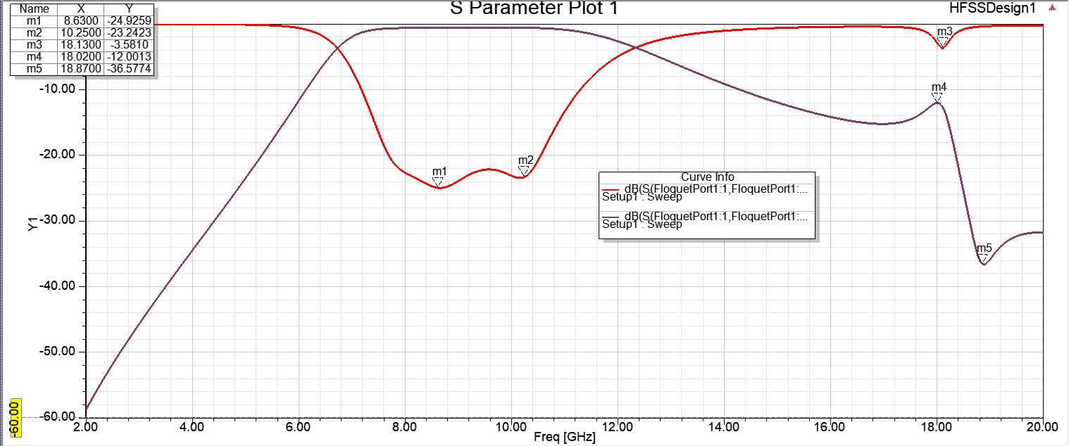
Results for S-Parameter
Results for S-parameter R_{xx} and R_{xy}

Slide 15
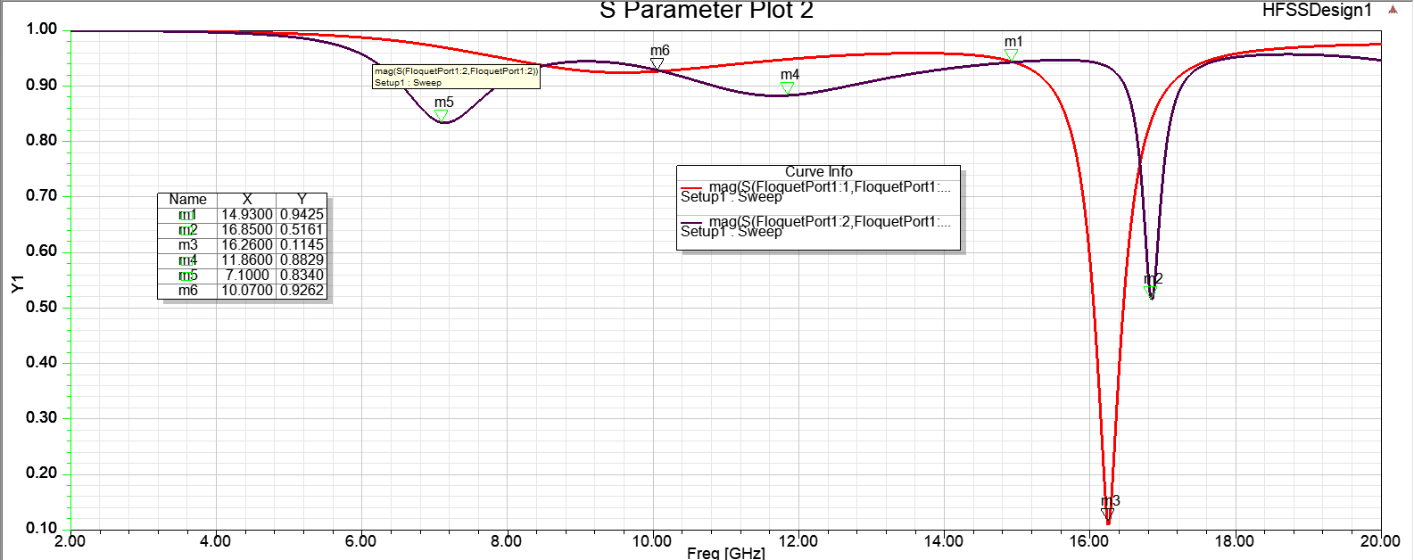
Results for S-parameter
Results for S parameter R_{u} and R_{v}

Slide 16


Polarization Conversion Ratio
Polarization Conversion Ratio (PCR) or efficiency signifies if the proposed polarization converter can convert the y-polarized incident wave to a CP one with both ultra-wide bandwidth and high efficiency.
It can be calculated using
Thus, This polarization converter can convert the y-polarized incident wave to a CP one with both ultra-wide bandwidth and high efficiency.
[5]

Slide 17
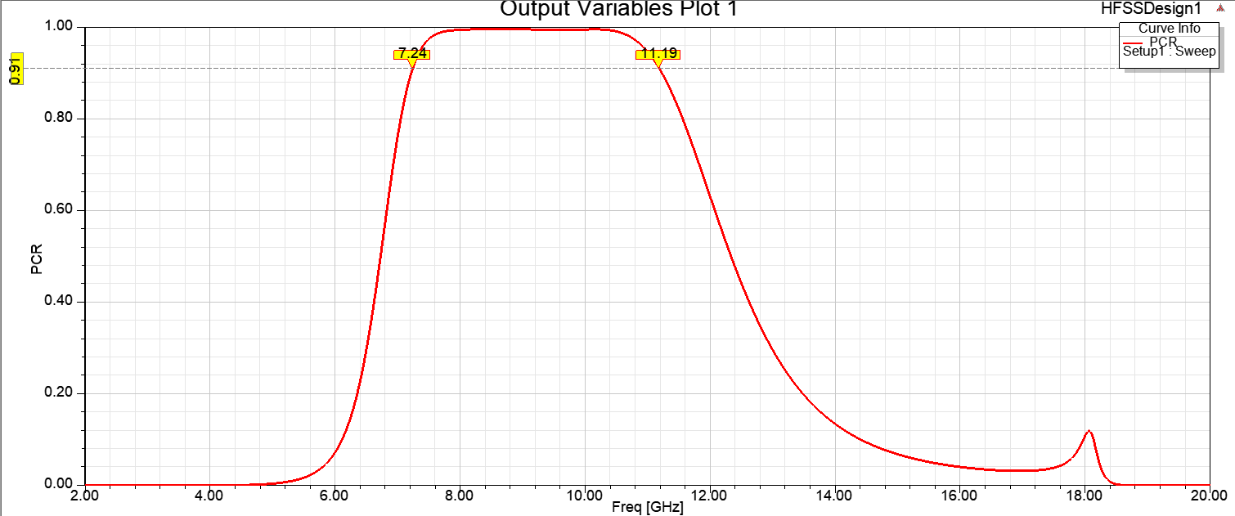
Results for PCR

Slide 18
Phase Difference
Phase difference (ɸ) is the measure of angle between R_{xx} and R_{xy} co and cross polarized components.
If the measure of angle is an odd multiple of 90º at a particular bandwidth then antenna is said to have shown circular polarization between a particular frequency bandwidth. [6]
We observe that At Frequencies –6.5GHz, 7.6GHz, 8.5GHz, 10.8GHz, 15.4GHz 16.3GHz, 17GHz and at 18GHz
180º Phase difference is achieved which is important in order to achieve RCS reduction.

Slide 19
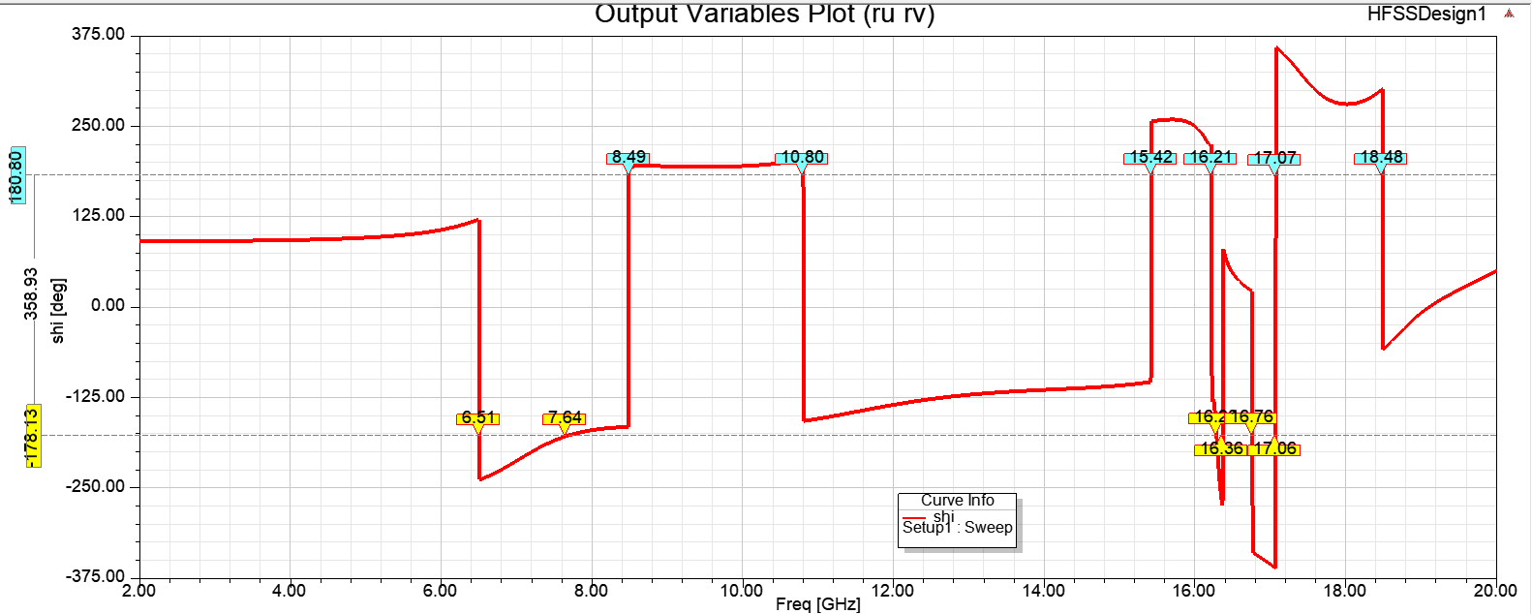
Results for Phase difference

Slide 20
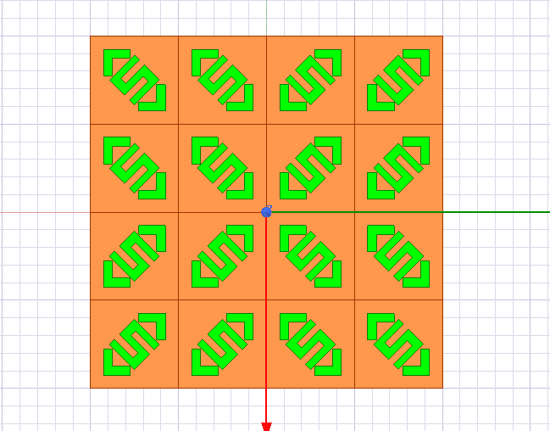
1 bit Coding for RCS
The unit cell or converter is arranged in 4 × 4 matrices as depicted in Fig.10.
Each of the matrix elements forms a 2 × 2 sub-array with the entire matrix resemblances an identity matrix. The ‘1’ in the identity matrix signifies the orientation of the Double L+S –shaped resonator along 45°, whereas ‘0’ signifies the orientation along -45°. [7]
(Fig.10) 4 × 4 matrix arrangement of the proposed converter for RCS reduction

Slide 21
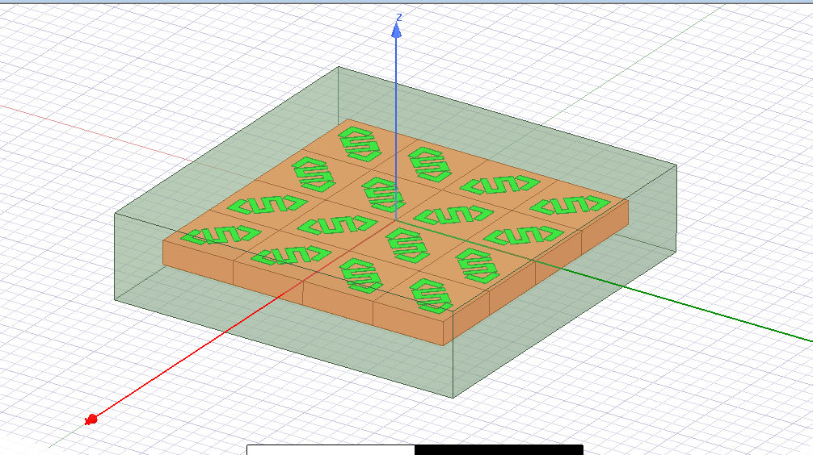
Metasurface inside Airbox
A vacuum box 1.4 meter square. This meets the requirement that PML
boundaries should be at least λ ⁄ 4 from the target as shown in (Fig.11)
(Fig.11) target is placed inside airbox

Slide 22
Boundary and Excitation
PML stands for Perfectly Matched Layer, which is a technique used in electromagnetic simulations to reduce the amount of electromagnetic waves that reflect off the boundaries of a simulation domain
On the surface of Air Box Perfectly Matched Layer (PML) Boundary is applied on the faces of Air Box as shown in (Fig.12)
An incident plane wave is a wave that propagates in one direction and is uniform in the directions perpendicular to its direction of propagation. [8]
An Incident Plane wave is applied as excitation on the meta surface as shown in
(Fig.13)

Slide 23
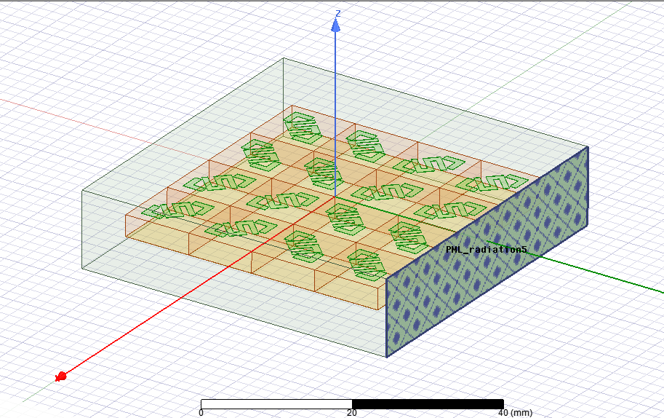
Applied PML Boundary
(Fig.12) PML boundary applied on every face of Air Box

Slide 24
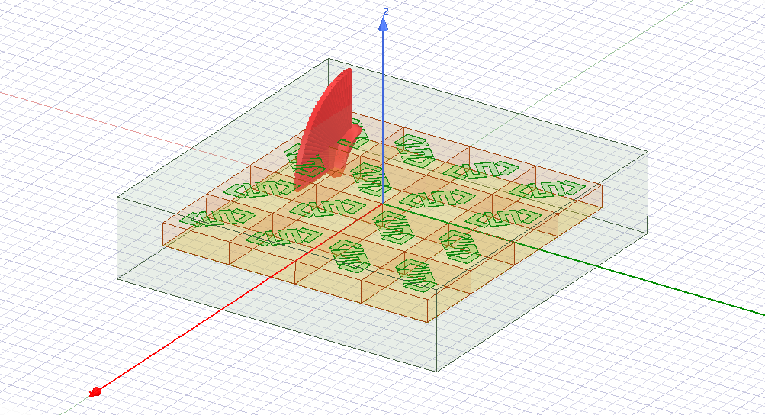
Applied Excitation
(Fig.13) Incident Plane Wave applied

Slide 25
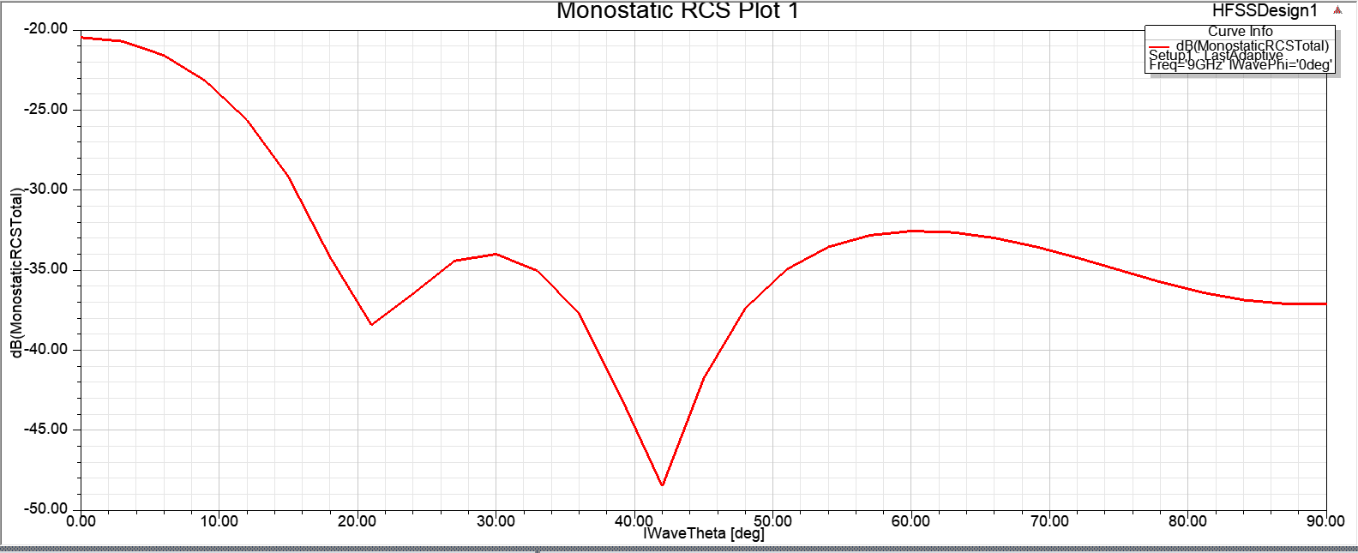
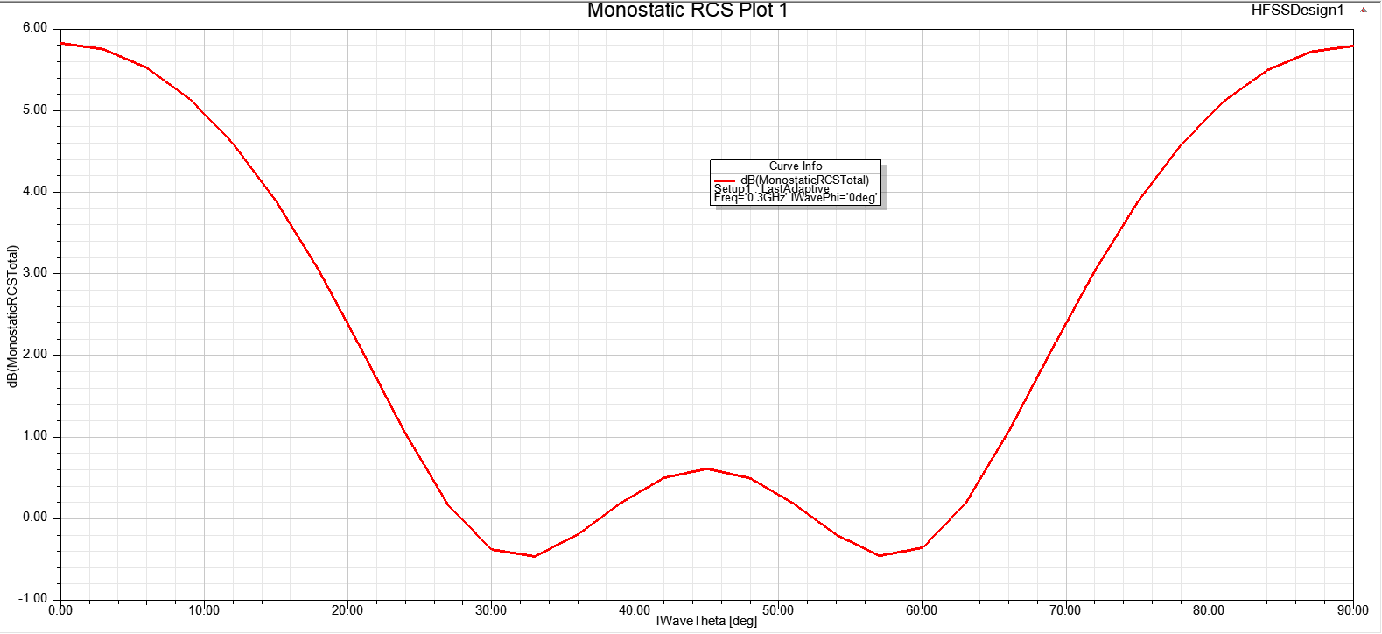
Monostatic RCS Plot
Monostatic RCS plot is a graphical representation of the RCS of an object as a function of the angle of incidence of the radar signal. The term "monostatic" refers to the fact that the radar
system is located at the same location as the target object, so the signal travels to and from the object along the same path. A monostatic RCS plot shows the variation in RCS as a function
of the angle of incidence of the radar signal.
Monostatic RCS plot for our designed metasurface
Monostatic RCS plot for perfect electric material (PEC)

Slide 26
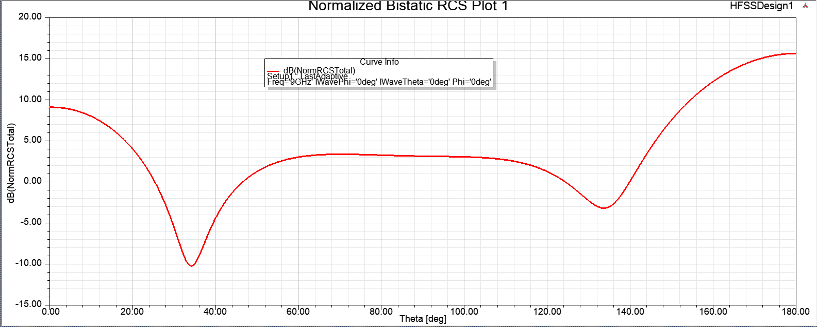
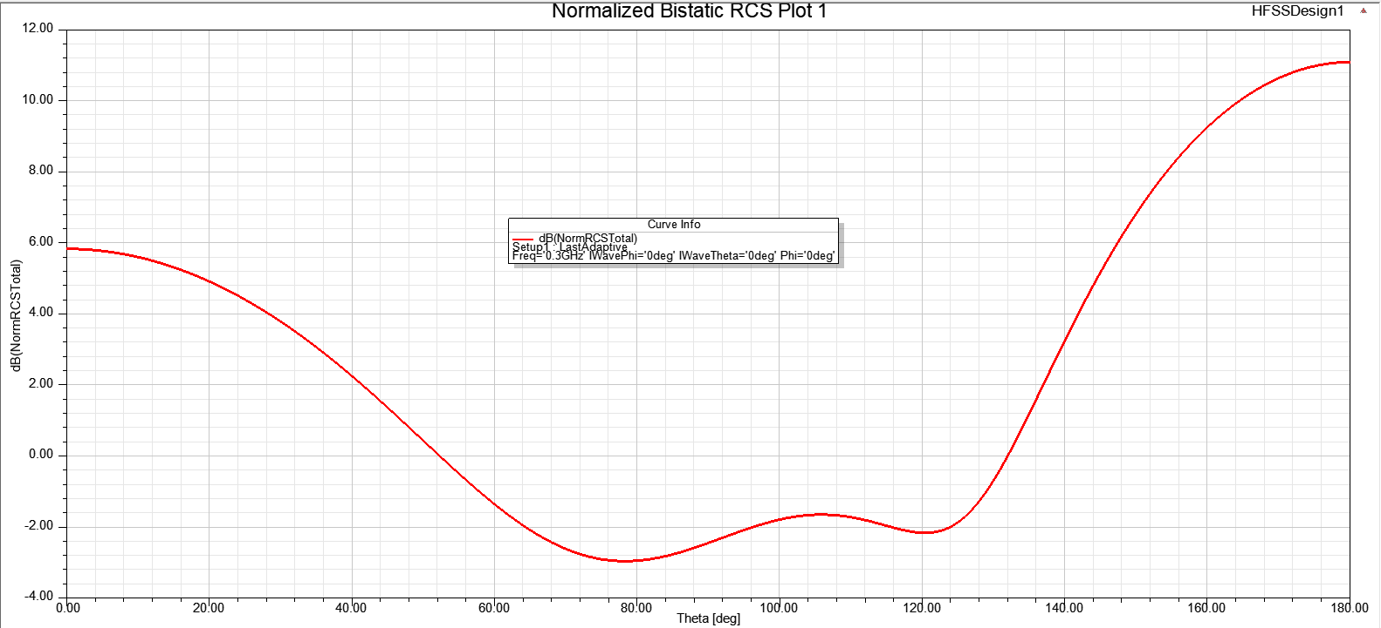
Bistatic RCS Plot
A bistatic RCS plot is a graphical representation of the RCS of an object as a function of the
bistatic angle. The term "bistatic" refers to the fact that the radar system and the target object are located at different locations, so the signal travels to and from the object along different paths.
Bistatic RCS plot for our designed metasurface
Bistatic RCS plot for PEC

Slide 27
Conclusion
We have designed our own structure after analysing and Understanding Journals and conference papers based out of RCS Reduction.
We continued working on this structure and by optimising the structure we have achieved reduction in Radar Cross Section Reduction.
Polarisation Conversion Ratio (PCR) is more than 90% between frequency range of 7GHz to 11GHz.
Phase difference is 180° in the frequency band where PCR is greater which is ideal for Radar cross section reduction.
Structure has passed above parameters, then we have designed a metamaterial surface with multiple unit cell in the form of 1-bit Coding.
Then applied appropriate Boundary and Excitation on the Air Box.
Plotted graph for Monostatic and Bistatic RCS report to analyse the reduction in RCS shown by our own meta surface in comparison to PEC.
From the RCS plot we can conclude that our meta surface has done significant reduction in RCS as compared to PEC. Power reflected by meta surface at different incident angle is very less as compared to PEC.

Slide 28
References
[0] Balanis, Constantine A. Antenna theory: analysis and design. John wiley & sons, 2015.
[1] S. Khan and T. F. Eibert, "A Dual-Band Metasheet for Asymmetric Microwave Transmission With Polarization Conversion," in IEEE Access, vol. 7, pp. 98045-98052, 2019, doi: 10.1109/ACCESS.2019.2929115.
[2] Al-Nuaimi, M. K. T., & He, Y. (2019, July). RCS Reduction of a Microstrip Antennas Using Cross Polarization Conversion Metasurface. In 2019 IEEE International Symposium on Antennas and Propagation and USNC-URSI Radio Science Meeting (pp. 1907-1908). IEEE.
[3] Pati, Shyam Sundar, et al. "Double E-Shaped Reflection Type Polarization Converter For Radar Cross Section Reduction." 2021 IEEE Indian Conference on Antennas and Propagation (InCAP). IEEE, 2021.
[4] S. Khan and T. F. Eibert, ‘‘A dual-band metasheet for asymmetric microwave transmission with polarization conversion,’’ IEEE Access, vol. 7, pp. 98045, 2019.
[5] D. Roddy, Satellite Communications. New York, NY, USA: McGraw-Hill,2001.
[6] Nama, Lavesh, Somak Bhattacharyya, and Pradip K. Jain. "A metasurface-based, ultrathin, dual-band, linear-to-circular, reflective polarization converter: easing uplinking and downlinking for wireless communication." IEEE Antennas and Propagation Magazine 63.4 (2021): 100-110.
[7]Lin, Baoqin, et al. "An ultra-wideband reflective linear-to-circular polarization converter based on anisotropic metasurface." IEEE Access 8 (2020): 82732-82740.
[8] Chatterjee, J., Mohan, A., & Dixit, V. (2022). Ultrawideband RCS Reduction of Planar and Conformal Surfaces Using Ultrathin Polarization Conversion Metasurface. IEEE Access, 10, 36563-36575.

